Slide 1
PGE 392K Project 1 Fall 2020
Shadab, Mohammad Afzal

Slide 2
1.1 . Pressure at 0.01 days and at steady state
Gridblock Index | Pressure at 0.01 days (psi) | Steady State Pressure (psi)
1 | 841.37 | 1142.17
2 | 1028.38 | 1311.22
3 | 1144.15 | 1296.25
4 | 841.92 | 1142.29
5 | 1029.10 | 1311.85
6 | 1163.77 | 1309.46
7 | 841.43 | 1142.88
8 | 1035.11 | 1314.58
9 | 1259.55 | 1362.90

Slide 3
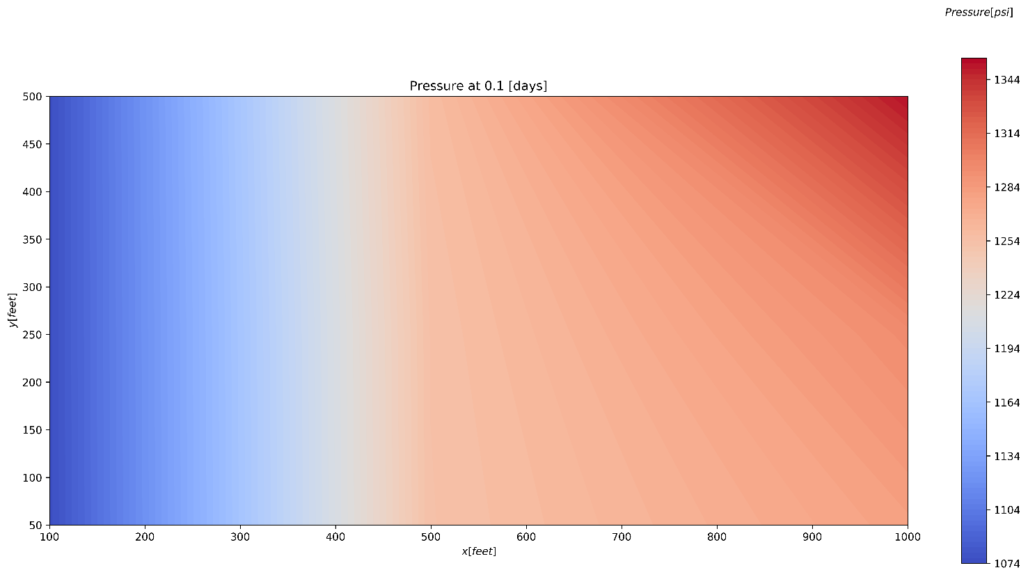
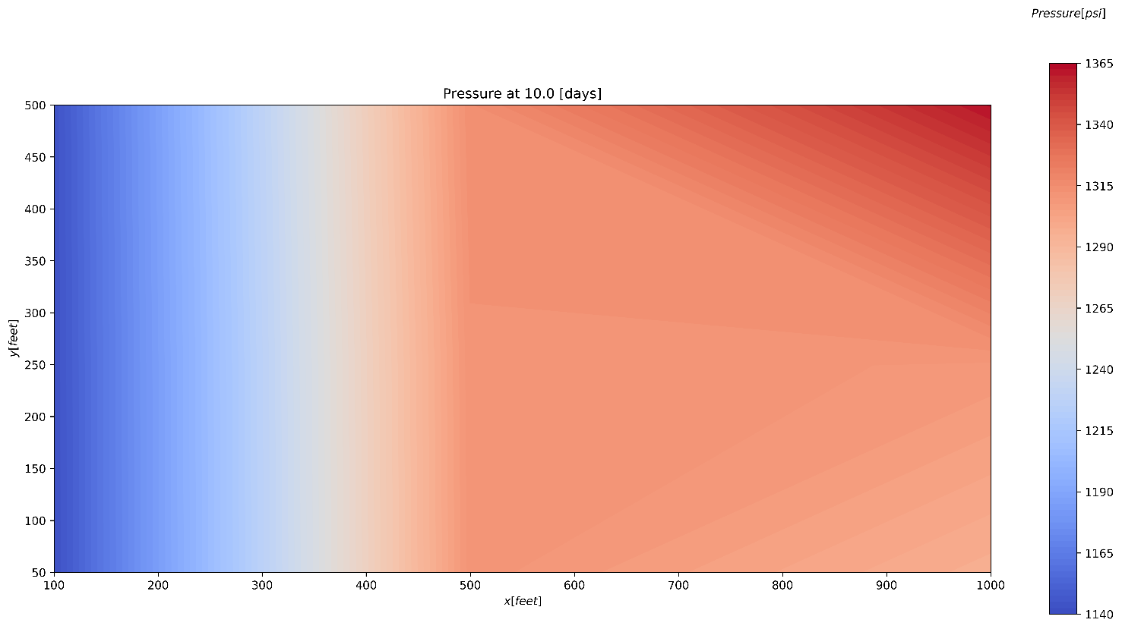
1.2 Filled contour plot of pressure at two interesting times
Early Time
Middle Time

Slide 4
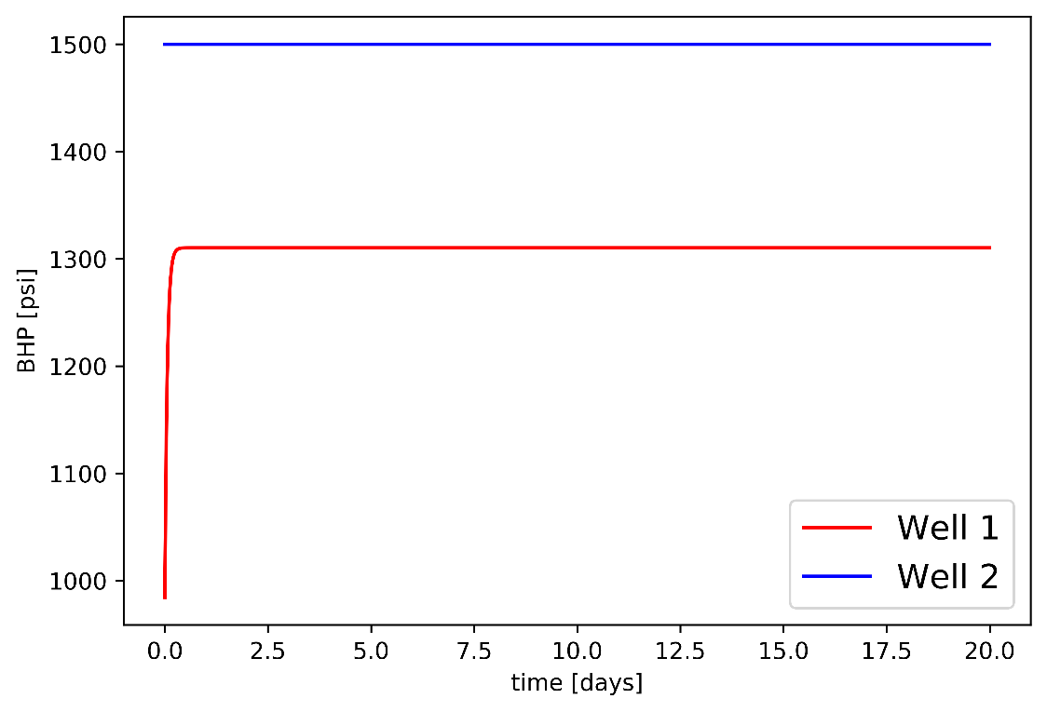
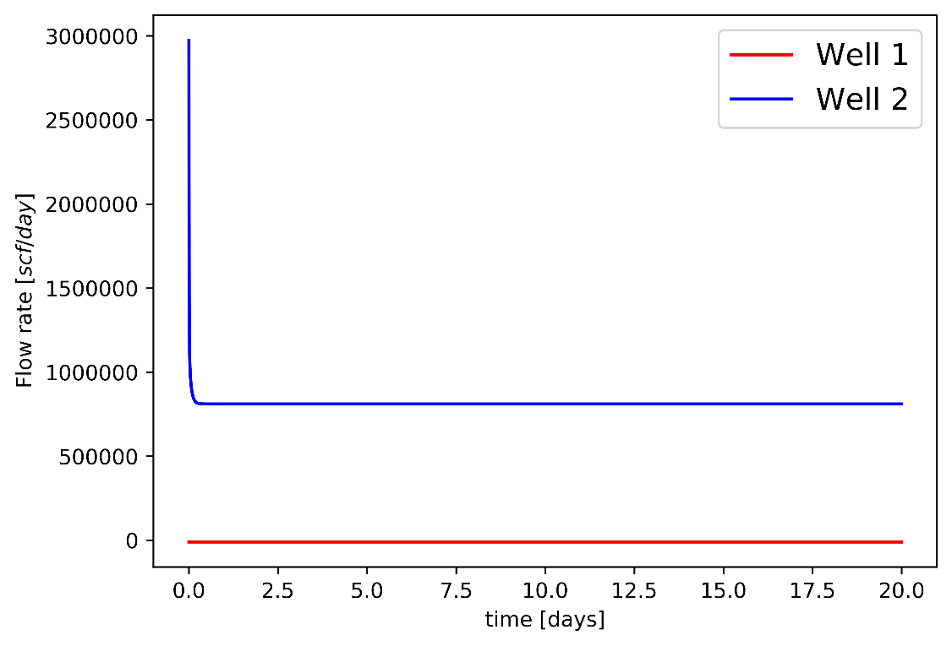
1.3 and 1.4 Well Pressure Vs Time and Well Rate Vs Time
Well Pressure Vs Time
Well Rate Vs Time

Slide 5
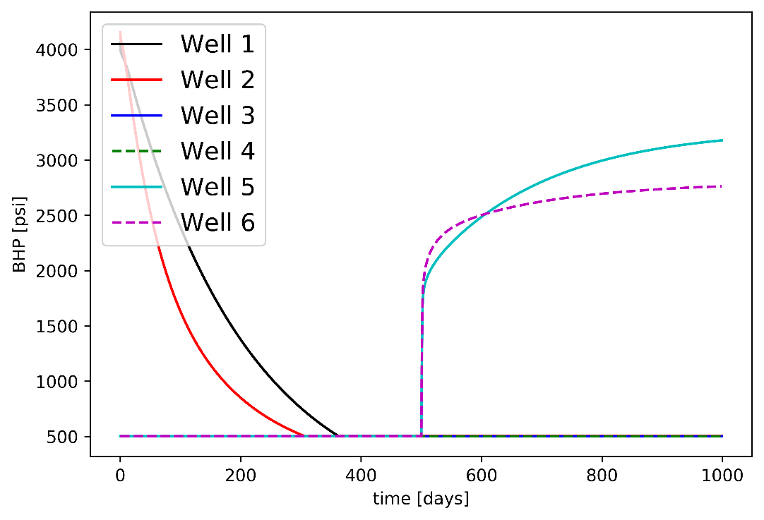
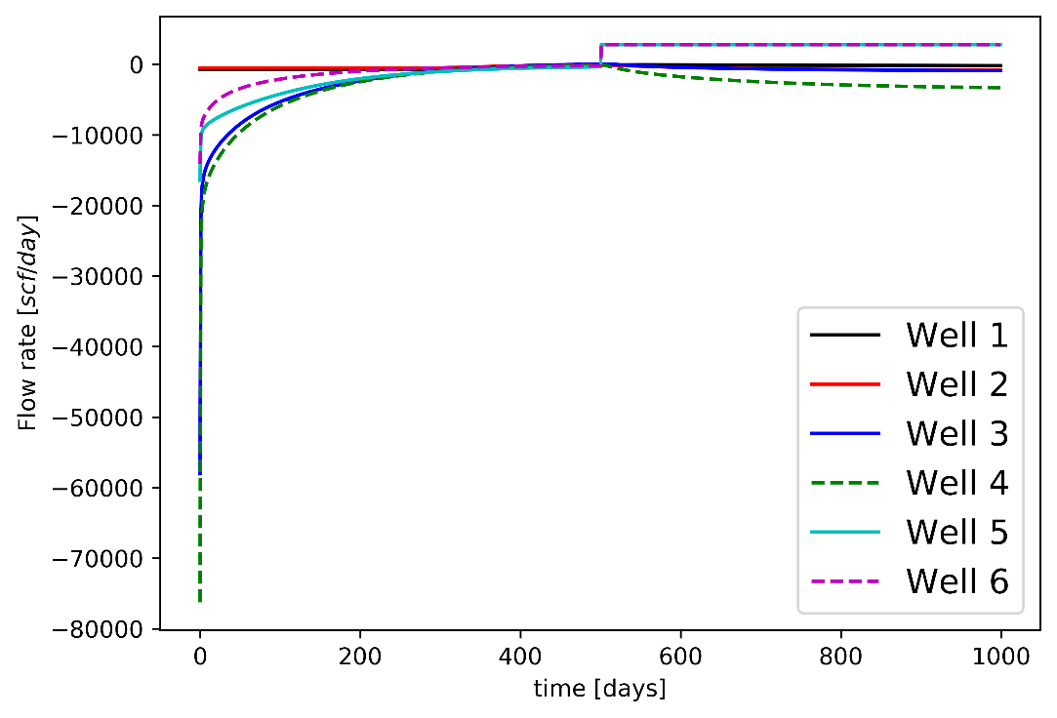
2.1 and 2.2 BHP Vs Time and Well Rate Vs Time
BHP(psi) Vs Time
Well Rate (scf/day) Vs Time

Slide 6
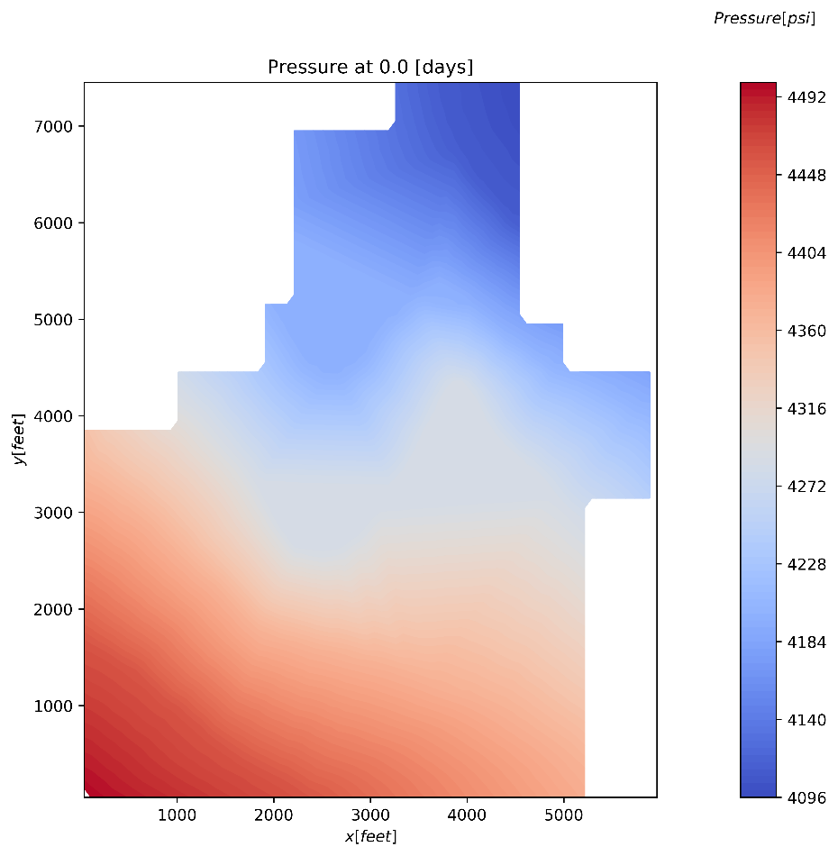
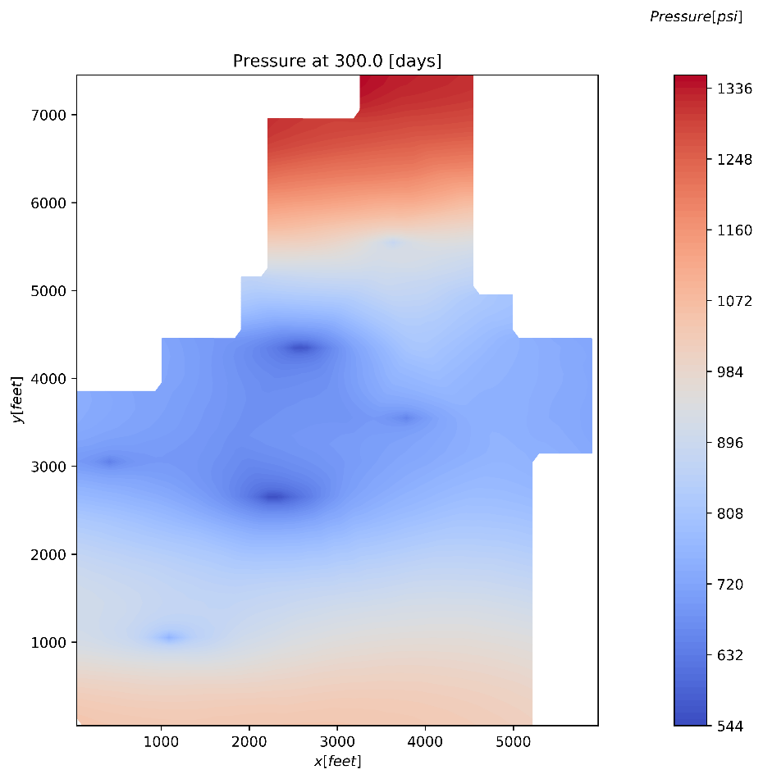
2.3 Contour Map of Pressure
Initial
300 days

Slide 7
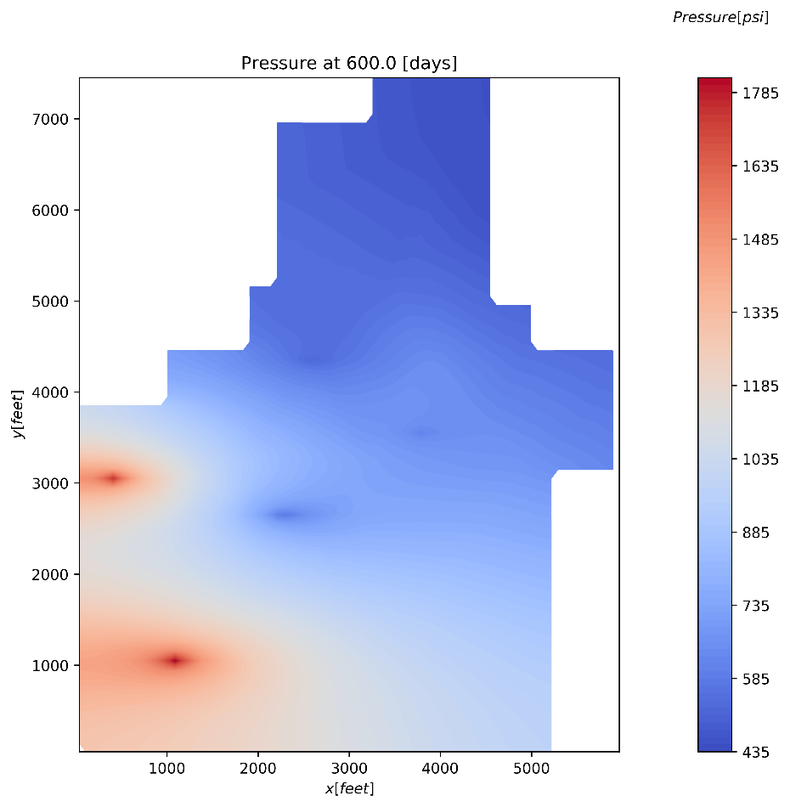
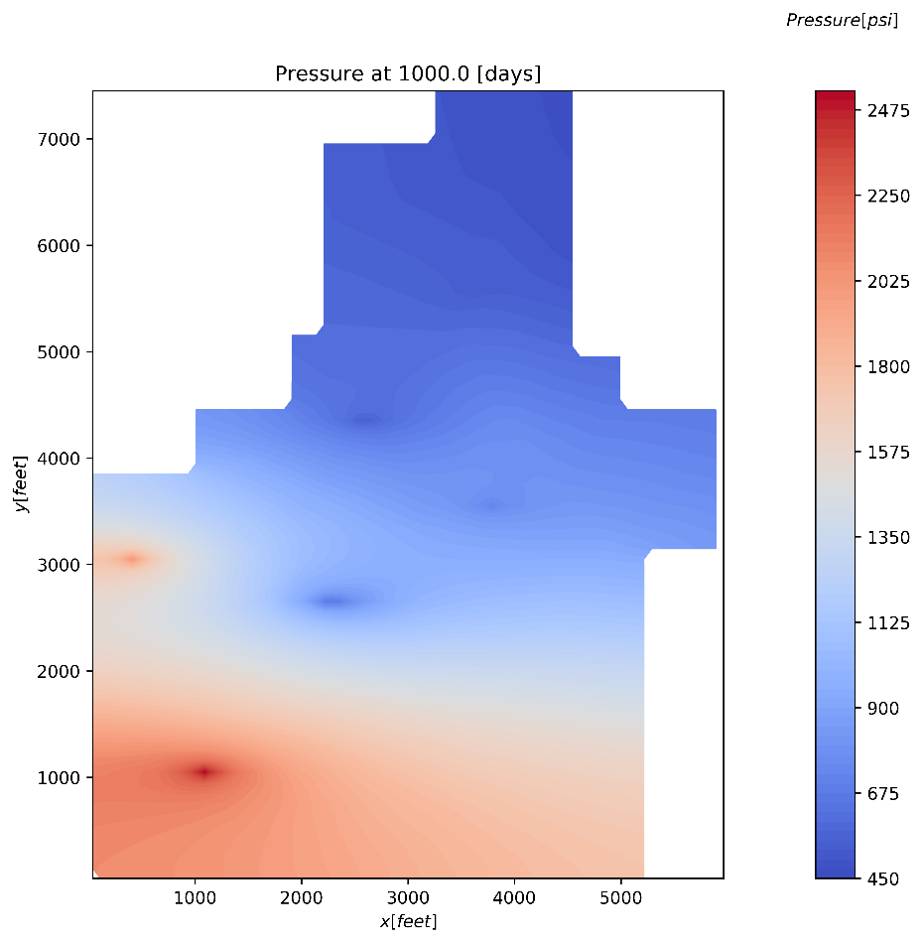
2.3 Contour Map of Pressure
600 days
1000 days

Slide 8
Table 1. Complete the following table. In some cases, the answer will be the same before and after the history match.
Well # | Propery | Value
1 | Block # | 4448 (Python numbering from 0)
 | Initial P (psi) | 4182.8
 | J (scf/day) | 5.64
 | P (psi) of block at 100 days | 2511.84
 | BHP (psi) at 100 days | 2392.45
 | P (psi) of block at 500 days | 519.12
 | Q (scf/day) at 500 days | -93.73
 | T between well block and block to the right of it | -11.36
2 | Block # | 2850
 | Initial P (psi) | 4285.5
 | J (scf/day) | 3.87
 | P (psi) of block at 100 days | 1761.64
 | BHP (psi) at 100 days | 1631.43
 | P (psi) of block at 500 days | 527.83
 | Q (scf/day) at 500 days | -98.22
 | T between well block and block to the right of it | -8.66
3 | Block # | 3473, 3474, 3475
 | Initial P (psi) | 4205.3, 4205.3, 4286.4
 | J (scf/day) | 5.30, 5.18, 5.19
 | P (psi) of block at 100 days | 841.38, 805.78, 873.92
 | BHP (psi) at 100 days | 502.5, 502.5, 502.5
 | P (psi) of block at 500 days | 500.03, 500.64, 500.22
 | Q (scf/day) at 500 days | 13.06, 9.62, 11.82
 | T between well block and block to the right of it | -8.43, -8.35, -10.42

Slide 9
Table 1. Complete the following table. In some cases, the answer will be the same before and after the history match.
Well # | Property | Value
4 | Block # | 2109, 2101, 2111
 | Initial P (psi) | 4286.4, 4285.5, 4285.5
 | J (scf/day) | 7.62, 5.28, 7.25
 | P (psi) of block at 100 days | 785.55, 766.40, 824.21
 | Q (scf/day) at 100 days | -2157.59, -1394.56, -2332.66
 | P (psi) of block at 500 days | 505.98, 505.49, 506.68
 | Q (scf/day) at 500 days | -26.49, -15.79, -30.29
 | T between well block and block to the right of it | -10.05, -9.85, -14.10
5 | Block # | 814
 | Initial P (psi) | 4448.9
 | J (scf/day) | 4.16
 | P (psi) of block at 100 days | 1510.43
 | Q (scf/day) at 100 days | 9.61546051
 | P (psi) of block at 500 days | 587.11
 | Q (scf/day) at 500 days | -352.34
 | T between well block and block to the right of it | -11.90
6 | Block # | 2405
 | Initial P (psi) | 4373.4
 | J (scf/day) | 3.65
 | P (psi) of block at 100 days | 1074.57
 | BHP (psi) at 100 days | 502.5
 | P (psi) of block at 500 days | 554.88
 | Q (scf/day) at 500 days | -191.14
 | T between well block and block to the right of it | -9.47
 | ky/kx | 0.15
 | Ct (1/psi) | 3.87E-6

Slide 10
Grading Rubric
 | Description | Points Possible | Received
Code | Code is well written and easy to follow, read, edit, and run. The code is flexible and allows for changes in inputs for a specific reservoir. Code runs quickly by employing sparse storage and written efficiently | 15
Heterogeneities | Interblock transmissibilities are calculated correctly. This includes the inclusion of variable permeability, thickness, porosity, and anisotropy | 10
Depth | Reservoir pressures are initialized properly, and gravity is modeled correctly in the simulator | 5
Wells | Variable number and location allowed. May be producer or injector and can follow a schedule. Constant rate or bottomhole pressure. Both vertical and horizontal wells possible. | 10
Validation | Model is validated against the 2D example and the results are correct | 20
Pressure plots | Filled contour plots of the pressure field in the reservoir for the application problem are included at early, intermediate, and late times. The plots should mimic the actual reservoir geometry (i.e. not show the “inactive” regions”) | 10
Well plots | Accurate plots of well rates and BHP versus time for every well. Include units | 10
Table | Values in the table (see ppt) are correct, +/-5%. (it is possible to lose points here and the original place, e.g. if the reservoir was not initialized properly). | 20
TOTAL |  | 100 | 100

